Slide 1
Two Step Mole Calculation
Example of Work

Slide 2
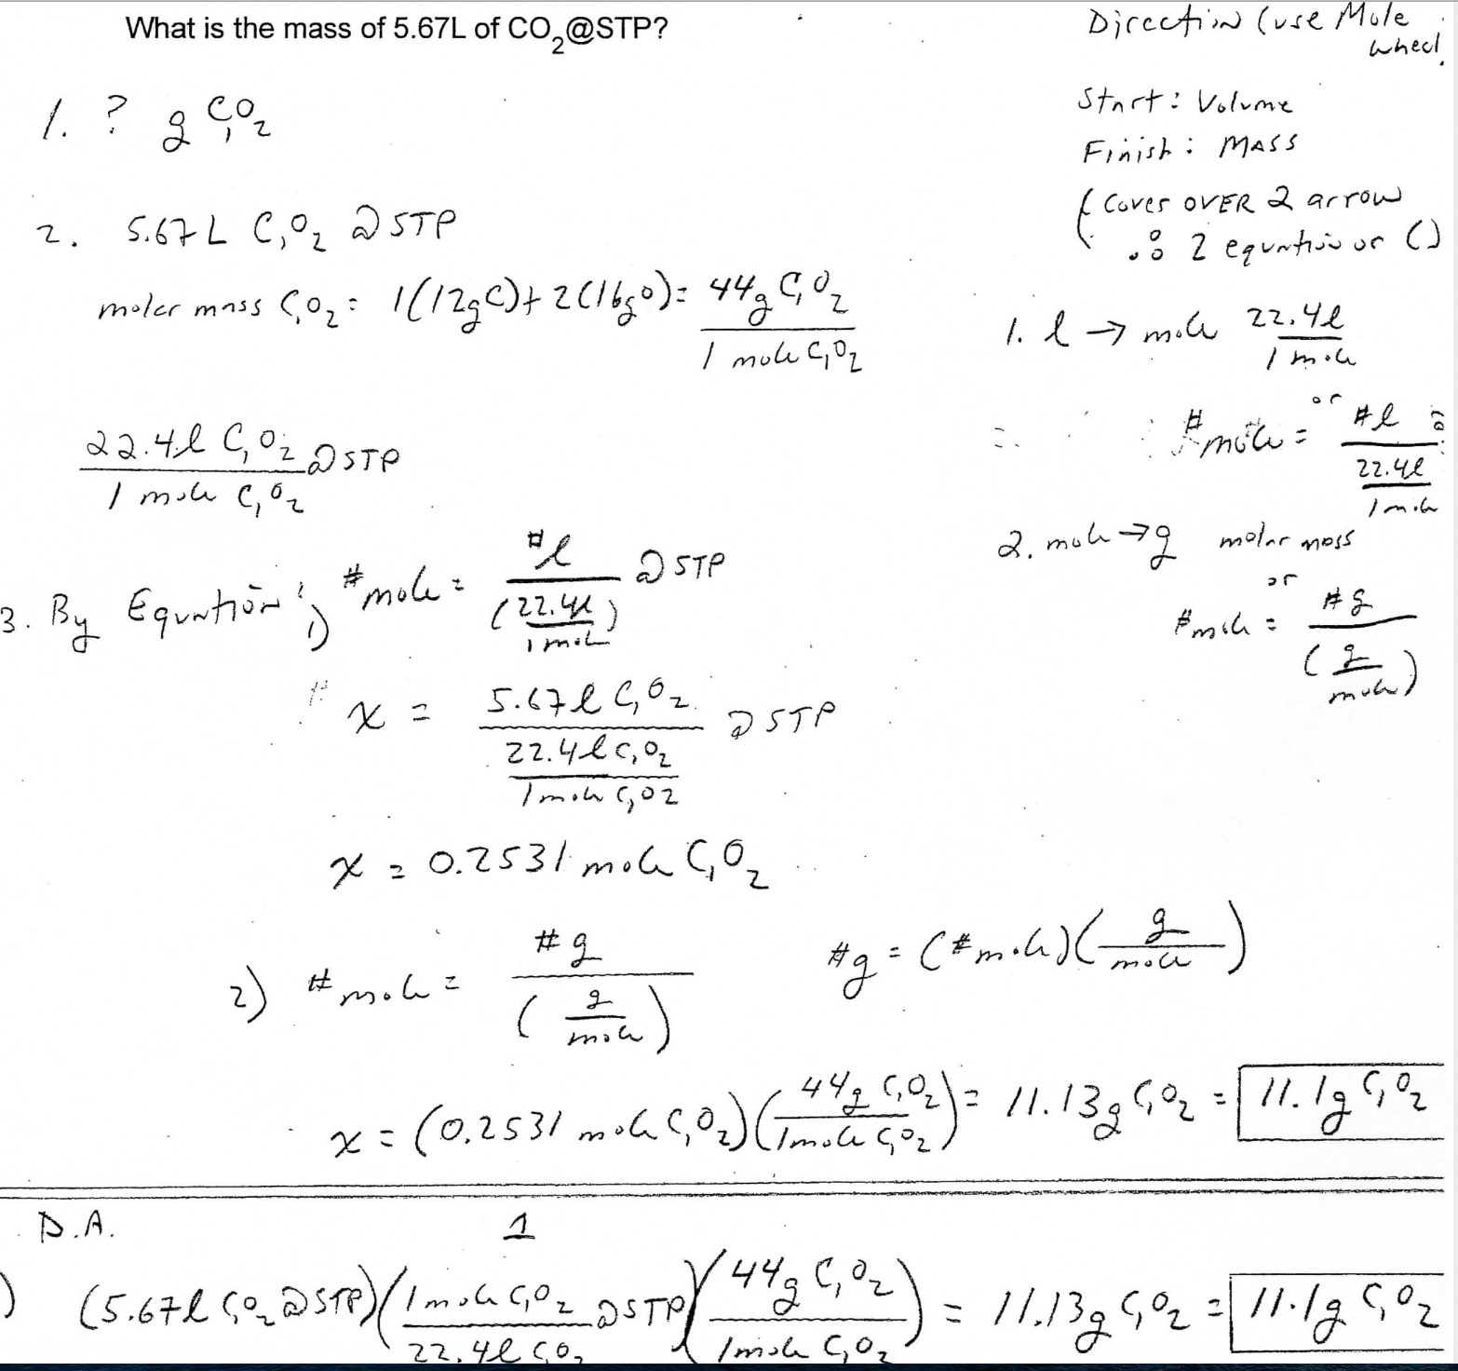

Slide 3
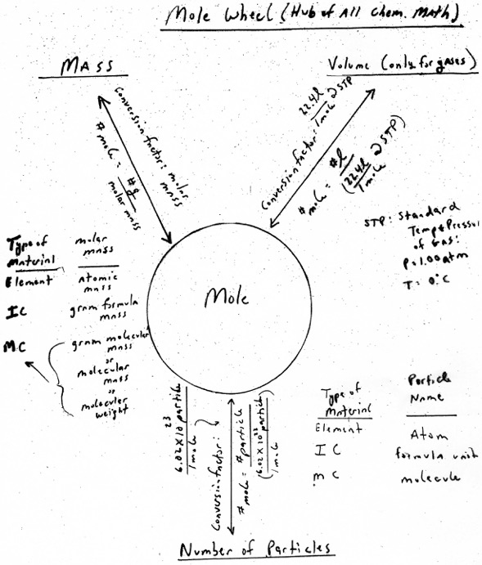

Slide 4
Another Example of Two Step Mole Calculations (with Mole Wheel)
How many grams of C₁O₂ do I have if I have 3.45E24 molecules of C₁O₂ ?

