Slide 1
Lewis Dot Structures
Exceed Octet Rule and Resonance
Honors Chem328 and CP Chem329

Slide 2
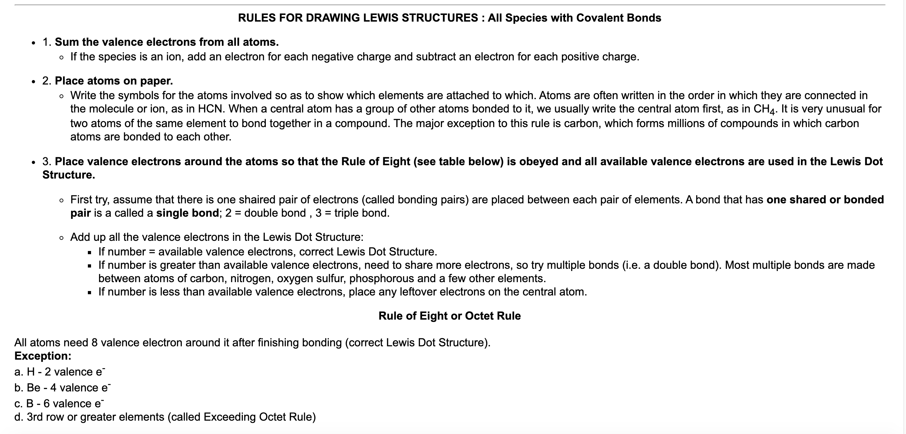
Direction/Steps for Determining Lewis Dot Structures (LDS)

Slide 3
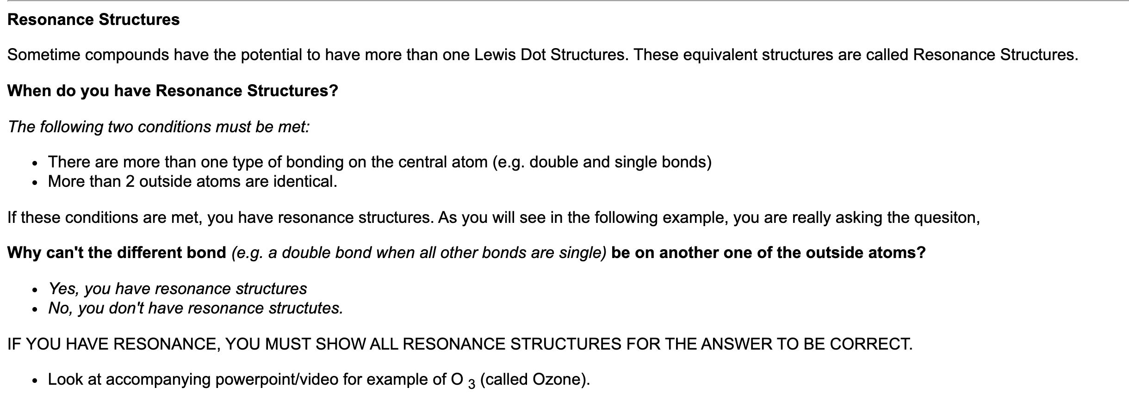
Lewis Dot Structures – Resonance Structures
Resonance Structure Notes below Link Soruce

Slide 4






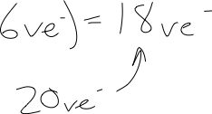








Example of determining LDS that have Resonance Structures

Slide 5

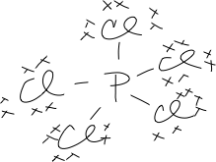









Example of determining LDS of
Central Atom that Exceed the Octet Rule
Note: Central atom must be in the 3rd row of Periodic Table or higher (3rd energy level or greater)
since these elements have available atomic “d” orbitals.

