Slide 1
Mole Concept – Grouping of Small Particles

Slide 2
Why is Mole Concept So Important to Chemistry?
Allows Chemists to mass out, count and find volume (gas particles only) of particles that are too small to do the above with individually.

Slide 3
History of the Mole Concept
Joseph Louis Gay-Lussac : Law of Combining Volumes:
When two gasses react together to form different products, the volumes of
the reactants and the products (if they are all still gasses) are all whole
numbers.
Lorenzo Romano Amedeo Carlo Avogadro de Quaregna e di Cerreto - better known
as Amedeo Avogadro: He said that the reason that Law of Combining
Volume works is the things in the volume are
made up of particles combining simple whole
number ratios (both in the reactant and products).
Avogadro hypothesis related gas volumes to the particles that made up the volume.

Slide 4
History of the Mole Concept (Page 2)
In years since Gay-Lussac and Avogadro, scientist changed Avogadro hypothesis particles from volume measurement to mass measurement.
Specifically, scientist knew enough about the elements to be able to explain the RELATIVE mass difference between elements (but not actual mass of element).
For example, they knew Carbon was 12X the mass of Hydrogen, etc.
But with any Relative scale, to make the relative number ACTUAL number, you need a reference (or basis) point. In other words, one of the Relative mass will have to be DEFINED (reference mass or element). They used Carbon atoms equal 12amu (atomic mass units). Then all the other know elements obtained a mass based off of this mass.

Slide 5
Mr. McLeod Explanation of Mole
We knew relative masses between elements
Assume that largest atom has 100 protons (p), 100 neutrons (n) and 100 electrons (e). In 1900 or so, scientists figured out mass of all subatomic particles with p&n being 1.67E-23g and e being 9.11E-28g. So if you do the math above, the mass of the most massive atom of an element is less than 1.67E-21g or 1.0E-21g.
So in the FOLLOWING DISCUSSION I WILL ASSUME MASS OF 1 HYDROGEN = !.0E-21G

Slide 6



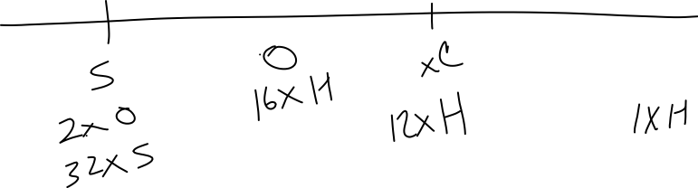




Slide 7




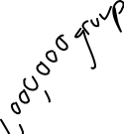

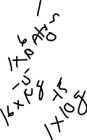














Slide 8





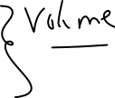




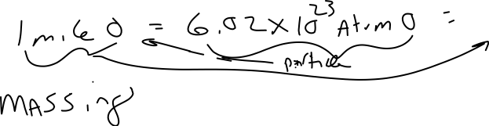








Slide 9
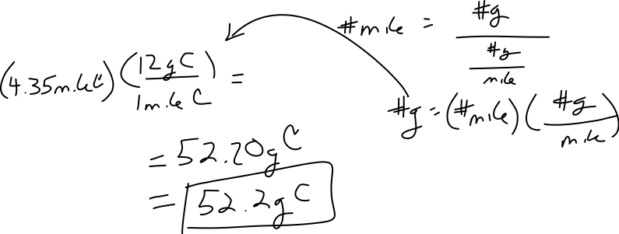



Example of Mass to Mole Calculations for Elements.
How many grams of Carbon do I have if I mass out 4.35 moles of C ?
Dimension Analysis
By Equation

Slide 10

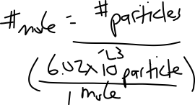




Three Mole Equations
(Massing) (Counting) (Voluming)
Mass to Mole Number of Volume to Mole Particles to Mole (only for gasses)

