Slide 1
Matter – General Information
Chem328 1st Year Chemistry
Revised 2015

Slide 2
A. Matter Flowchart
MATTER
MIXTURE – More than One Base unit or Particle Type
PURE SUBSTANCE- ONE BASE UNIT OR PARTICLE TYPE
Homogeneous Mixture
(solution)
Heterogeneous Mixture
Compound
Element

Slide 3
A. Matter Flowchart
Examples:
graphite
pepper
sugar (sucrose)
paint
soda
element
hetero. mixture
compound
hetero. mixture
Solution (homo. mixture)

Slide 4
B. Pure Substances
Element
composed of identical atoms
EX: copper wire, aluminum foil

Slide 5
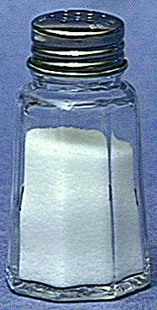
B. Pure Substances
Compound
Def: 2 or more elements chemically combined in a fixed mass ratio (also fixed # ratio)
properties differ from those of individual elements
EX: table salt (NaCl)

Slide 6
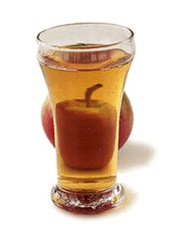
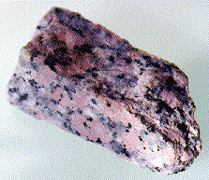
C. Mixtures
Variable combination of 2 or more pure substances.
Heterogeneous
Homogeneous

Slide 7
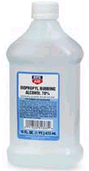
C. Mixtures
Homogeneous Mixture
Called a Solution
Particles are very small and evenly distributed (affects of this is)
No Tyndal Effect (see slide below)
Particles don’t settle out
Particles don’t filter out
EX: rubbing alcohol

Slide 8
C. Mixtures
Heterogeneous
medium-sized to large-sized particles
particles may or may not settle
Has Tyndall Effect (see slide below)
EX: milk, fresh-squeezed lemonade

Slide 9
Difference Between Types of Heterogenous Mixtures
Colloid – Don’t settle out Ex: Jello
Suspension – Do settle out Ex: Muddy H₂O₁

Slide 10
Tyndall Effect
When particles are aggregated together or themselves are large enough to they affect light passing by.
Examples: Colloids and Suspension (solution do not have Tyndall Effect)
Picture: Left container is colloid and right container is solution.

Slide 11
C. Mixtures
Examples:
tea
muddy water
fog
saltwater
Italian salad dressing
Answers:
Solution
Heterogeneous
Heterogeneous
Solution
Heterogeneous

